Slide 1

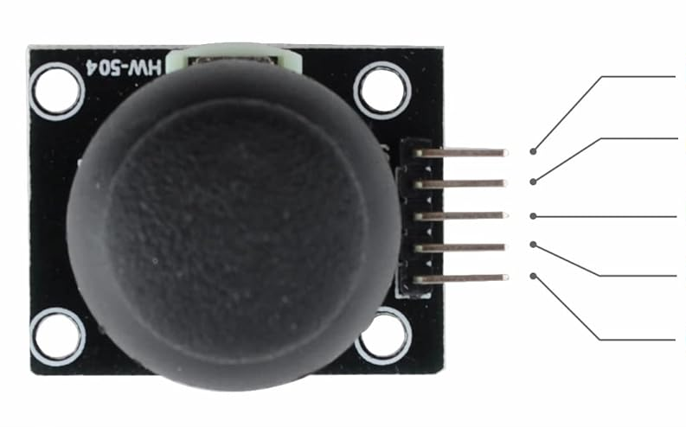
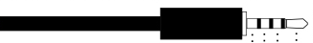
Mono cable
Sleeve
Tip
SW
TRRS audio cable
VRY
VRX
+5V
Sleeve
GND
Ring 2
Ring 1
Tip

Slide 2
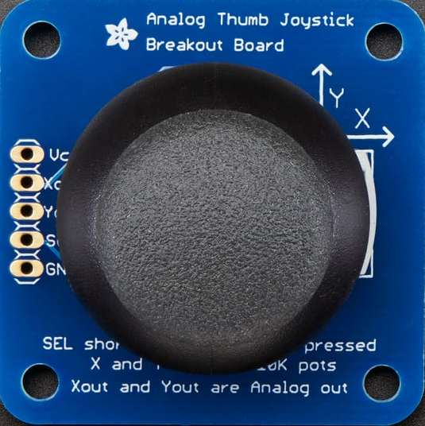
TRRS audio cable
Sleeve
Ring 2
Ring 1
Tip
VCC
X out
Y out
Tip
Sel
Sleeve
GND
Mono cable

Slide 3
